Slide 1
HR Interview & Meeting Analyzer Enterprise-Grade AI Dashboard for Audio Intelligence
Vanshika Kumawat
Infosys Virtual Internship Program (Batch 8)
January 2026

Slide 2
Problem Statement
Spoken data (interviews, meetings, podcasts) is unstructured and difficult to analyze.
Manual note-taking is time-consuming, inconsistent, and subjective.
Recruiters lack tools to quickly search, compare, and summarize interview content.
Need for scalable, objective, and auditable analysis of audio conversations.

Slide 3
Project Overview
Problem
Manual interview evaluation
Unstructured audio data
Difficult to scale recruitment AI-based audio intelligence system
Outcome
Structured insights
Recruiter decision support
Time-efficient evaluation
Solution
AI-based audio intelligence system
Automated transcription & analysis
Core Functionality
Transcription
Segmentation
Sentiment & Emotion Analysis
Keyword Extraction

Slide 4
Objectives
Automate transcription using ASR
Segment conversations with speaker roles
Analyze sentiment and emotion
Extract keywords for topic navigation
Provide AI summaries and recruiter decisions

Slide 5
System Architecture Overview
Audio Input
Preprocessing
ASR (Whisper)
Segmentation
NLP Analysis: Keywords | Sentiment | Emotion
Visualization: Dashboards & Charts
Recruiter Decision: Hire / Hold / Reject
Whisper converts audio into timestamped text
Noise handling and audio standardization
Interview or meeting audio file is provided by the user
Conversation divided into logical speech segments
Keywords, sentiment, and emotion extracted
Interactive charts and dashboards generated
Automated recruiter recommendation (Hire / Hold / Reject)

Slide 6
Audio Preprocessing
Format standardization (WAV, sampling rate).
Noise handling and normalization.
Ensures consistent input quality for ASR models.
Improves transcription accuracy across varying audio conditions.
Automatic Speech Recognition(ASR)
Produces timestamped transcripts.
Suitable for HR interviews and professional meetings.
Handles accents, conversational tone, and background noise.
Model: OpenAI Whisper
Topic Segmentation
Divides transcripts into coherent conversational segments.
Uses sentence structure, timestamps, and semantic cues.
Enables:
Navigation by topic
Speaker-wise analysis
Focused review of key responses
Summarization Approaches
Abstractive Summarization
Preserves original wording.
Preserves original wording.
Reliable and simple.
Ideal for HR quick scans and factual review.
Reliable and simple.
Ideal for HR quick scans and factual review.
Extractive Summarization

Slide 7
Keyword Extraction
Speaker Emotion Timeline
Identify core topics for fast candidate search
TF-IDF with n-grams
Benefits:
Quickly locate skills and experience
Filter candidates by role-specific phrases
Surface repeated themes for calibration
Goal:
Stopword and low-information filtering
Highlights HR and professional terms
Enables keyword-based navigation and filtering
Supports aggregated insights across candidates
Tracks positive, neutral, and negative sentiment.
Candidate confidence or hesitation
Interviewer neutrality
Emotional trends over time
Segment-wise polarity analysis using VADER.
Identifies:
Evaluation Metrics
Measuring ASR Performance
Word Error Rate (WER): substitutions, deletions, insertions
Accuracy: percentage of correctly transcribed words
Track improvements across models and preprocessing
Flag low-confidence segments for human review
Set HR quality thresholds for automated decisions

Slide 8
Technology Stack
This technology stack ensures high transcription accuracy, advanced analytics, and scalable enterprise deployment.
Speech & Audio
Speech & Audio Processing
OpenAI Whisper
PyDub
Natural Language Processing
NLTK
TF-IDF (Scikit-learn)
Sentiment & Emotion Analysis
NLP & AI
Visualization & Interface
Visualization & UI
Streamlit
Plotly
Matplotlib
Keyword Cloud
Backend & DevOps
Backend & Evaluation
Python 3
jiwer (WER, Accuracy)
Git & GitHub

Slide 9

Repository & Execution
GitHub: springboardmentor13579x-proj / Automated-Podcast-Transcription-and-Topic-Segmentation
Run Backend: python -m src.main
Launch UI: streamlit run src/ui_app.py

Slide 10
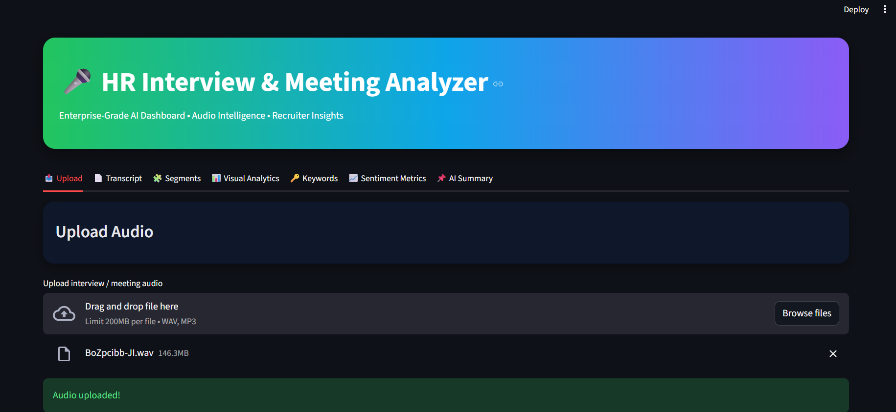
User Interface (Dashboard)

Slide 11
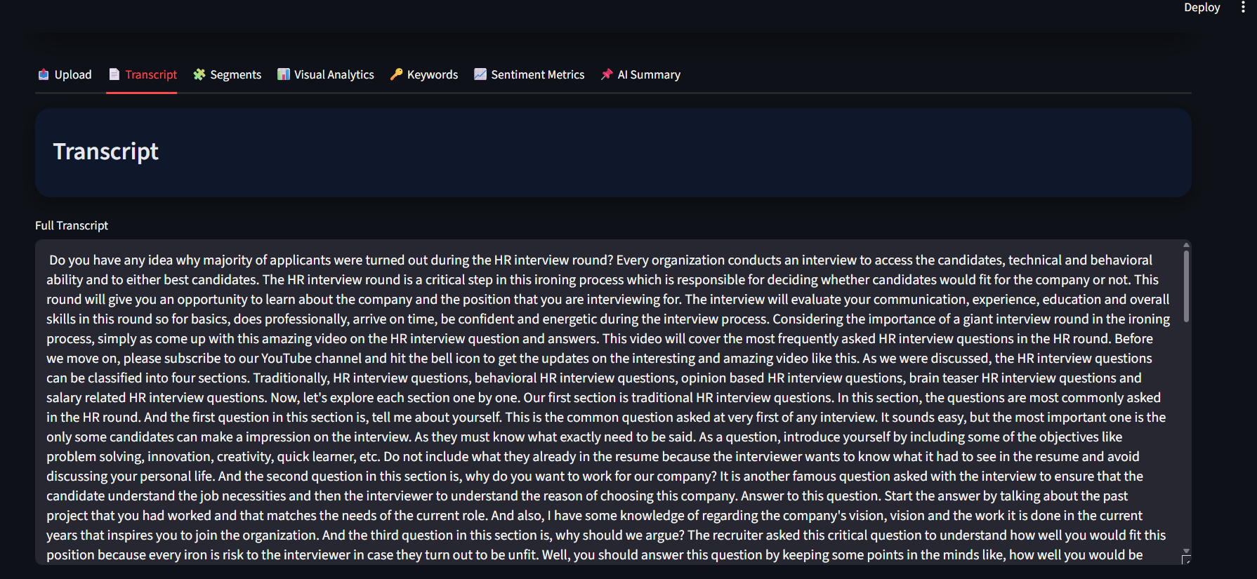
Transcript Generation
Whisper converts audio to text with timestamps
Full transcript shown for audit and review
Foundation for segmentation and analysis

Slide 12
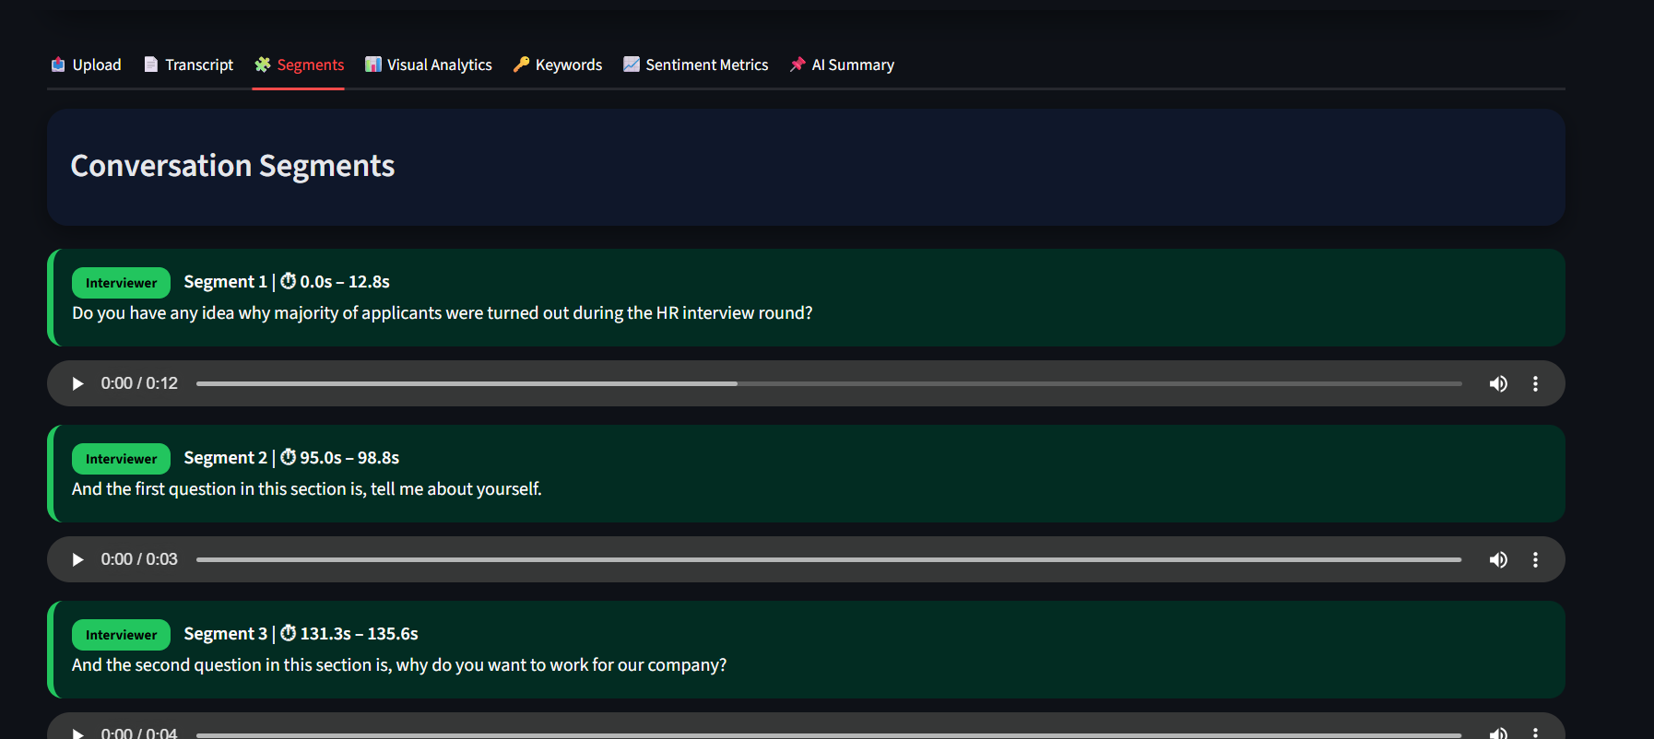
Segmentation & Speaker Detection
Each segment includes:
Speaker (Interviewer / Candidate / Narrator)
Start–end timestamp
Text + audio playback
Narrator used only for intro & outro
Ensures structured interview flow

Slide 13
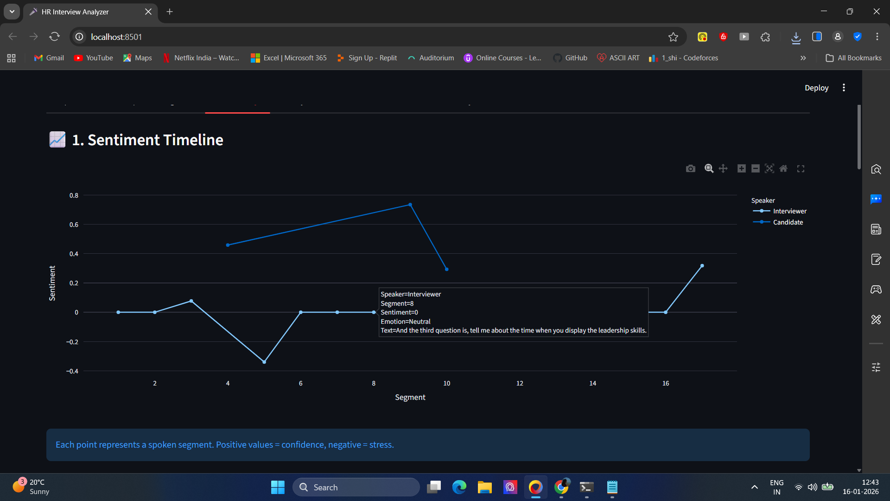
Visualization 1: Sentiment Timeline
Tracks emotional tone across segments
Positive → confidence
Negative → stress / hesitation
Impact: Detects response quality over time

Slide 14
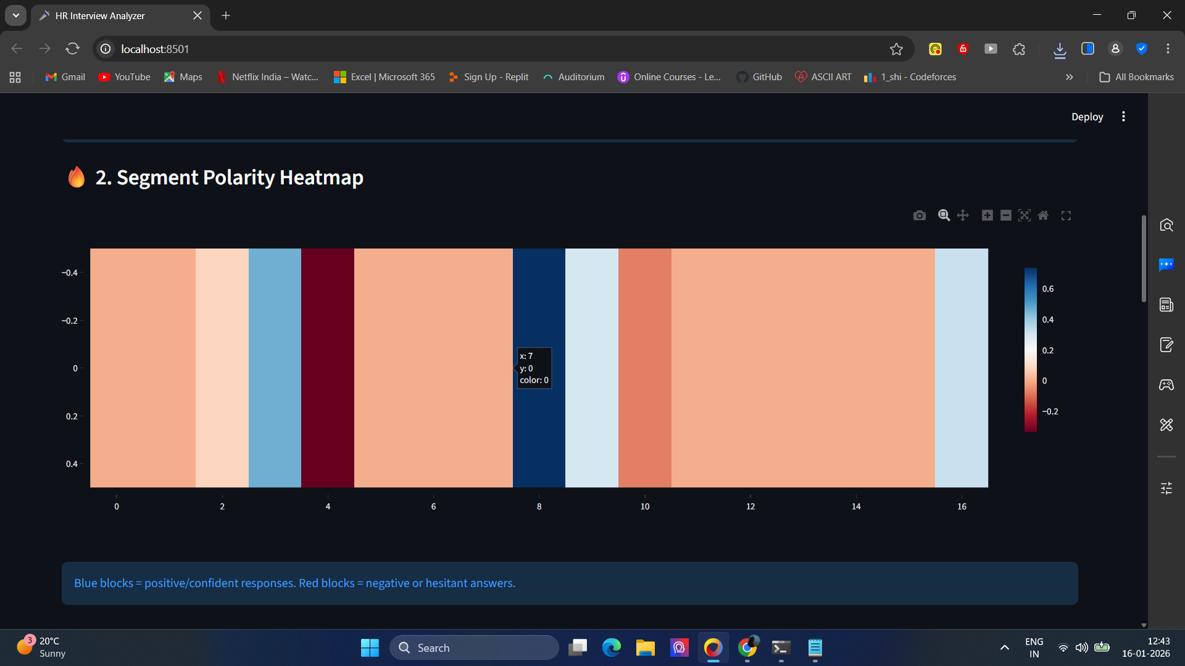
Visualization 2: Polarity Heatmap
Color-coded sentiment per segment
Blue → confident
Red → negative / hesitation
Light → neutral
Impact: Instantly identifies weak response zones

Slide 15
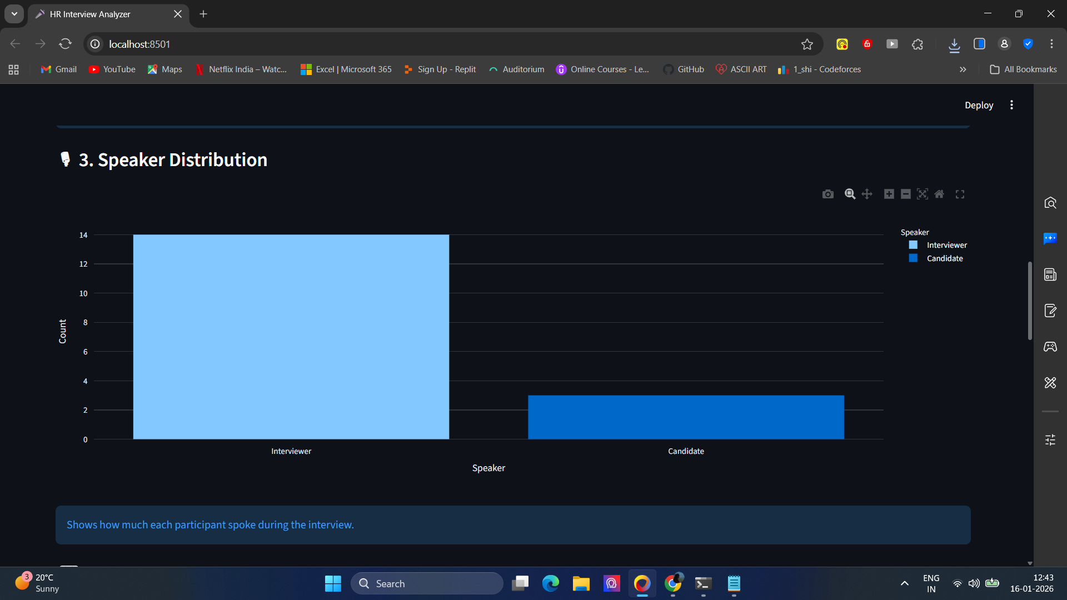
Visualization 3: Speaker Distribution
Measures interviewer vs candidate participation
Detects conversational dominance
Highlights engagement imbalance

Slide 16
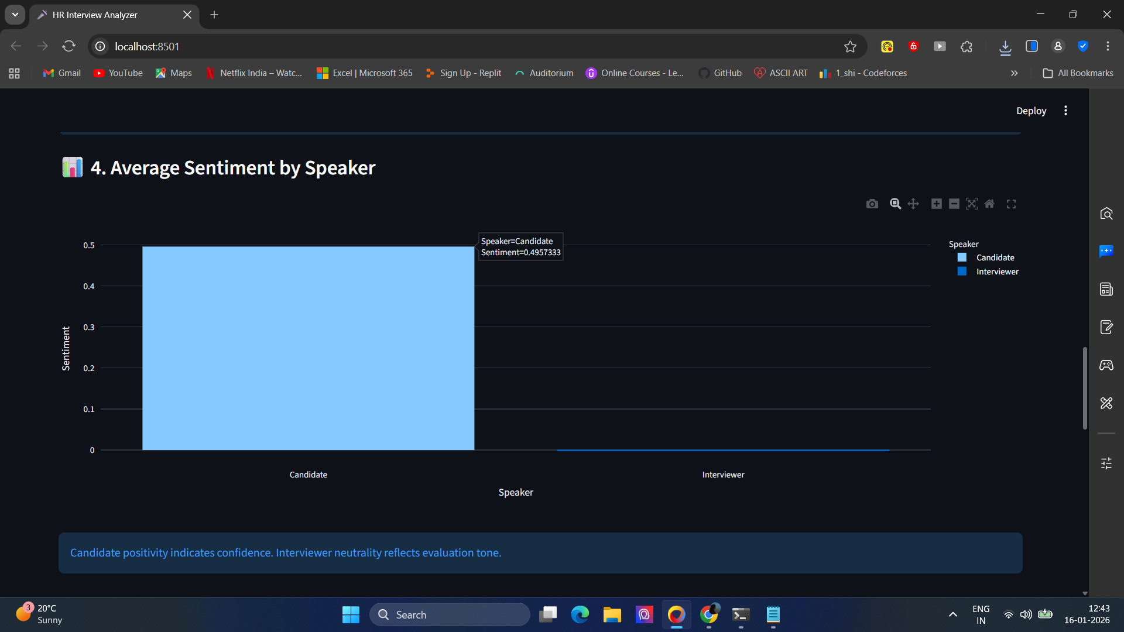
Visualization 4: Average Sentiment by Speaker
Compares emotional tone:
Interviewer (neutral, evaluative)
Candidate (confidence, positivity)

Slide 17
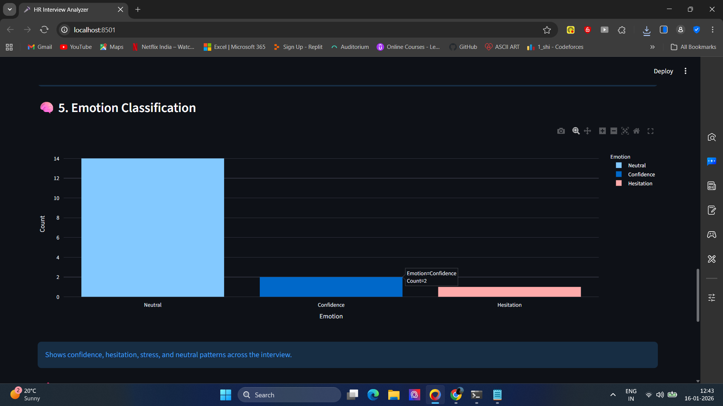
Visualization 5: Emotion Classification
Classifies segments into:
Confidence
Neutral
Hesitation / Stress
Impact: Evaluates emotional stability

Slide 18
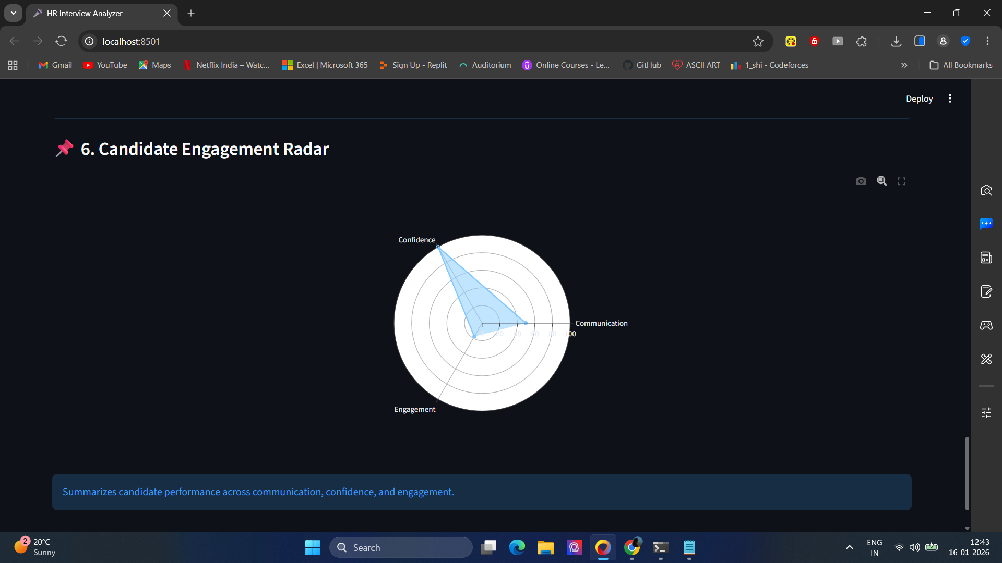
Visualization 6: Engagement Radar
Multi-dimensional candidate assessment:
Communication
Confidence
Engagement
Impact: Holistic performance score

Slide 19
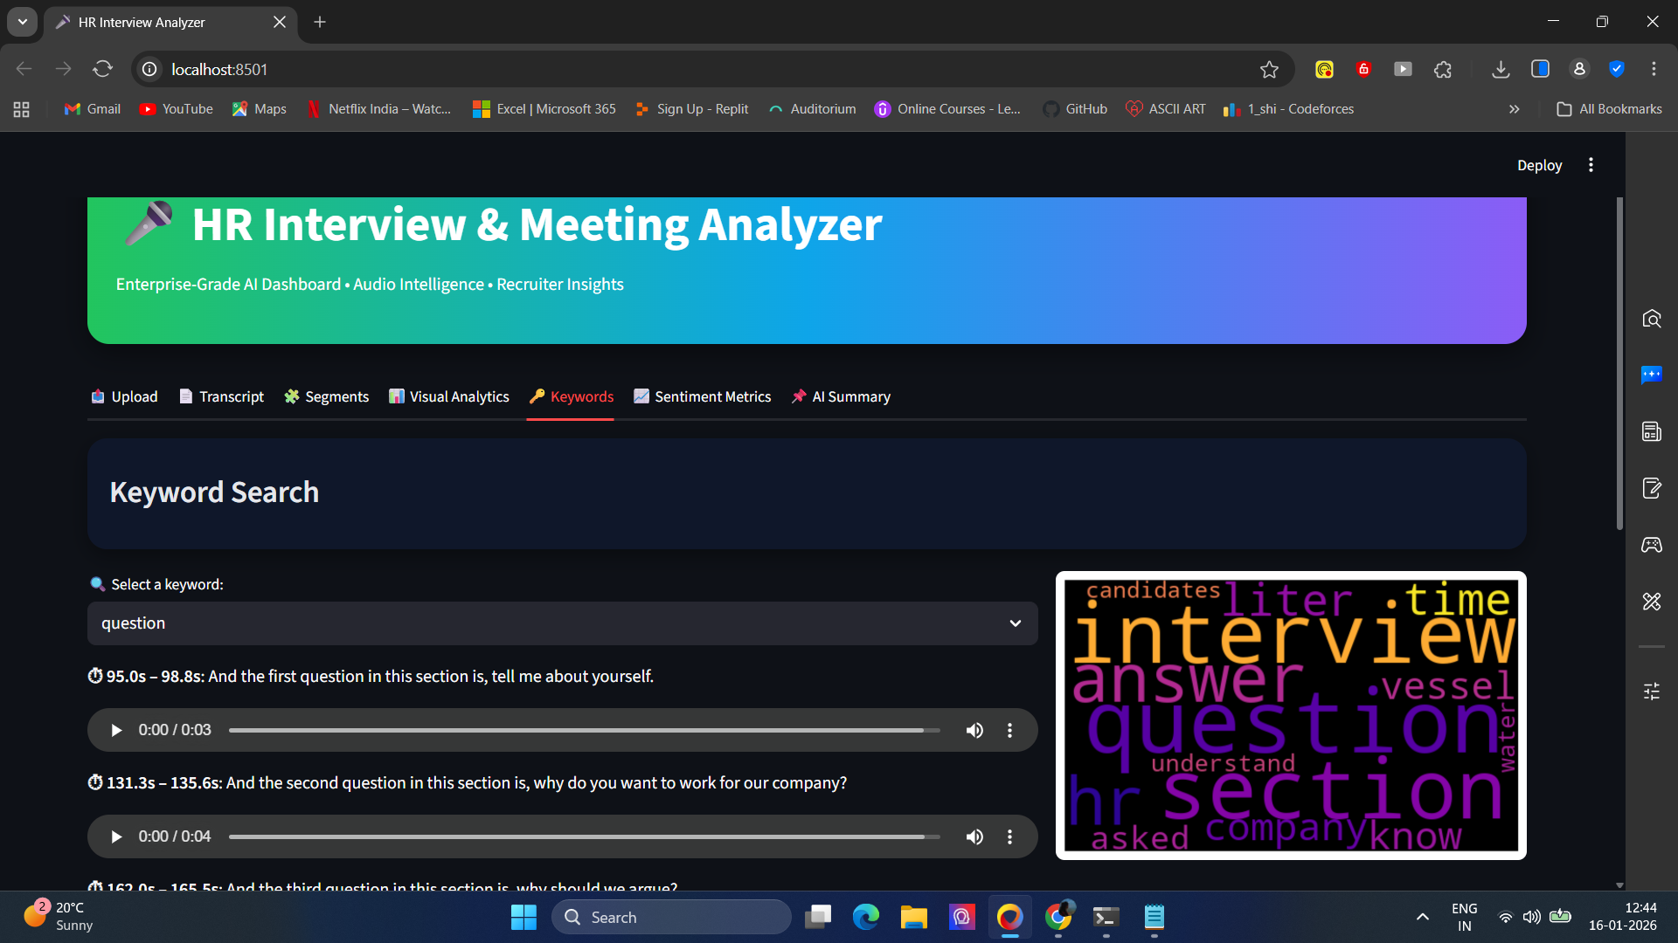
Keyword Intelligence
TF-IDF extracts top topics
Click keyword → jump to matching audio segments
Enables targeted recruiter review

Slide 20
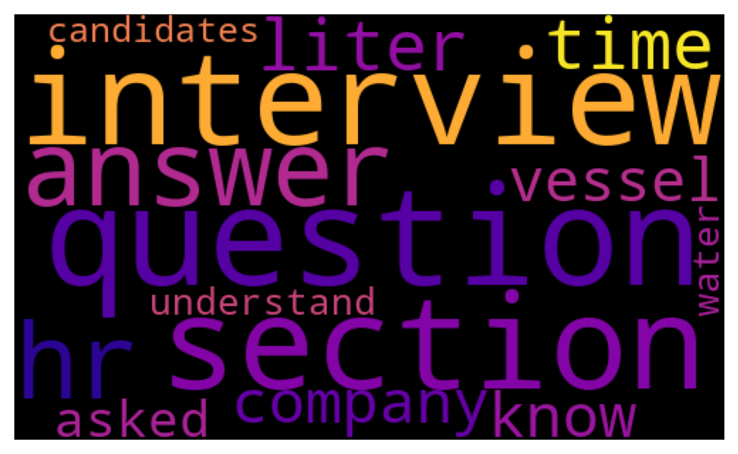
Keyword Cloud
Visual importance of extracted terms
Shows dominant interview themes
Example Keywords: interview, round, candidates, company, hr, ability, access, applicants

Slide 21
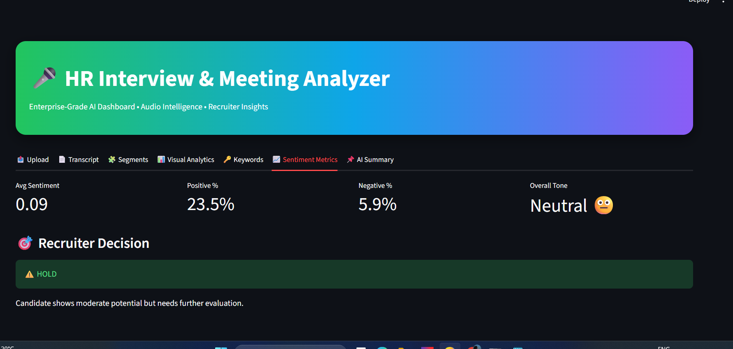
Sentiment Metrics
Average Sentiment
Positive / Negative percentage
Overall Emotional Tone
Purpose: Quick emotional summary of the interview

Slide 22
Recruiter Decision Logic
Rule-based scoring on:
Sentiment
Emotion balance
Engagement
Outputs:
Hire
Hold
Reject

Slide 23
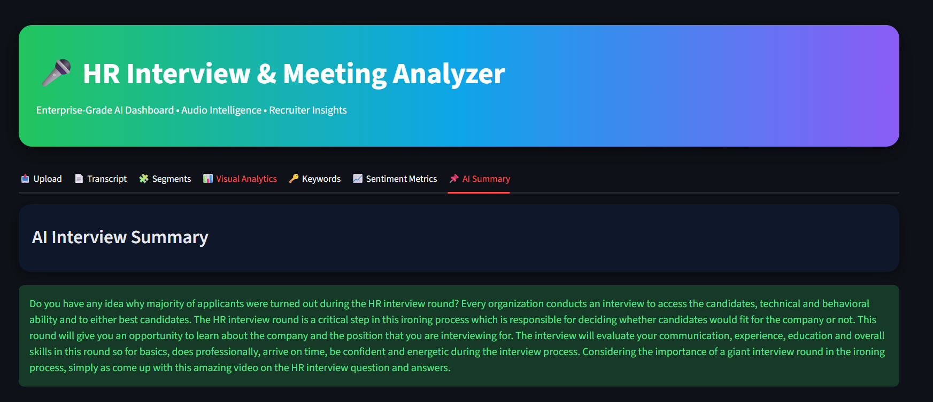
AI-Generated Summary
Summarizes entire interview (not just first lines)
Captures:
Key points
Candidate strengths & weaknesses
Final session conclusion

Slide 24
System Outputs
transcripts/asr/*.txt – Raw transcripts
segments/*.txt – Timestamped segments
docs/keywords.txt – Extracted keywords
docs/asr_evaluation.csv – WER, CER, Accuracy
results/Documentation.pdf – Final report
Experimental Results (Sample Audio)
File: BoZpcibb-JI.txt
WER: 0.2099
CER: 0.1278
Accuracy: 79.01%
Keywords: interview, round, candidates, company, hr, ability, access, applicants
Decision: HOLD

Slide 25
Use Cases
HR Interviews:
Automated candidate evaluation
Bias-reduced insights
Audio-linked review
Corporate Meetings:
Participation analysis
Sentiment-driven decisions
Podcasts & Lectures:
Topic navigation
Accessibility
Knowledge extraction

Slide 26
Challenges & Limitations
Limited transcript availability Many YouTube videos do not provide accessible English transcripts or restrict API access.
ASR accuracy dependency Background noise, accents, and overlapping speech can affect transcription quality.
Rule-based NLP analysis Emotion detection, speaker identification, and hiring logic are heuristic-based, not deep learning models.
Contextual sentiment limitations Professional interview language often appears neutral despite meaningful responses.
Human judgment remains essential AI insights support recruiters but cannot replace final human decision-making.

Slide 27
Conclusion
End-to-end AI system: backend pipeline + enterprise dashboard
Reliable ASR (79.01% accuracy), meaningful keywords, emotion-aware insights
Automated recruiter decisions support fair hiring
Scalable for interviews, meetings, podcasts, and accessibility
Transforms raw audio into actionable intelligence

Slide 28
Future Scope
Advanced speaker diarization for accurate speaker detection
Transformer-based NLP models for deeper semantic analysis
Multilingual interview and meeting analysis
Real-time interview transcription and sentiment tracking
Integration with enterprise HR systems (ATS)

Slide 29
THANK YOU
QUESTIONS?

